Slide 1
Laws of Open and Closed Queuing Systems
Software Performance Engineering

Slide 2
Our analysis thus far
We define metrics for each system to measure performance
We use the exponential distribution
  To analyze inter-arrival times in a Markovian stochastic system
  For a single random variable, e.g. “customers arriving”
We use multiple random variables to compute various metrics
  Customer arrival
  Service time
Systems have more than one queue!
  Bottleneck analysis
  M/M/m queues where m>1
Systems can be open or closed!

Slide 3
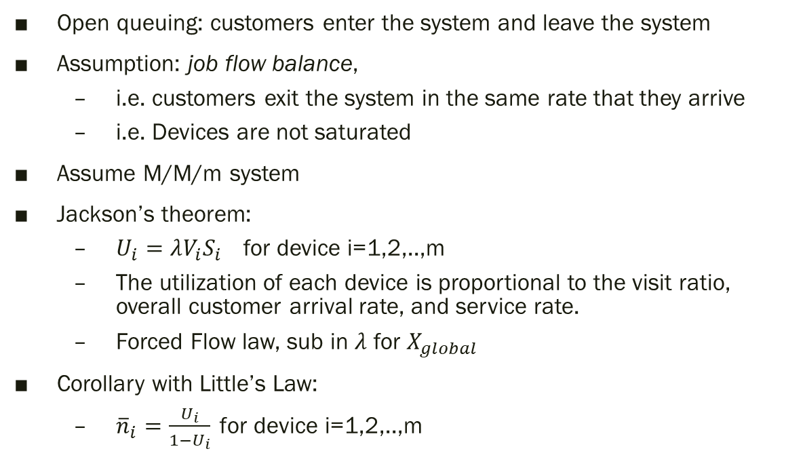
Open Queuing: Jackson’s Theorem
Open queuing: customers enter the system and leave the system
Assumption: job flow balance,
  i.e. customers exit the system in the same rate that they arrive
  i.e. Devices are not saturated
Assume M/M/m system
Jackson’s theorem:
  $U_{i}=λV_{i}S_{i}$ for device i=1,2,..,m
  The utilization of each device is proportional to the visit ratio, overall customer arrival rate, and service rate.
  Forced Flow law, sub in $λ$ for $X_{global}$
Corollary with Little’s Law:
  ${\overline{n}}_{i}=\frac{U_{i}}{1−U_{i}} \text{for} \text{device} \text{i}\text{=1,2,..,}\text{m}$

Slide 4
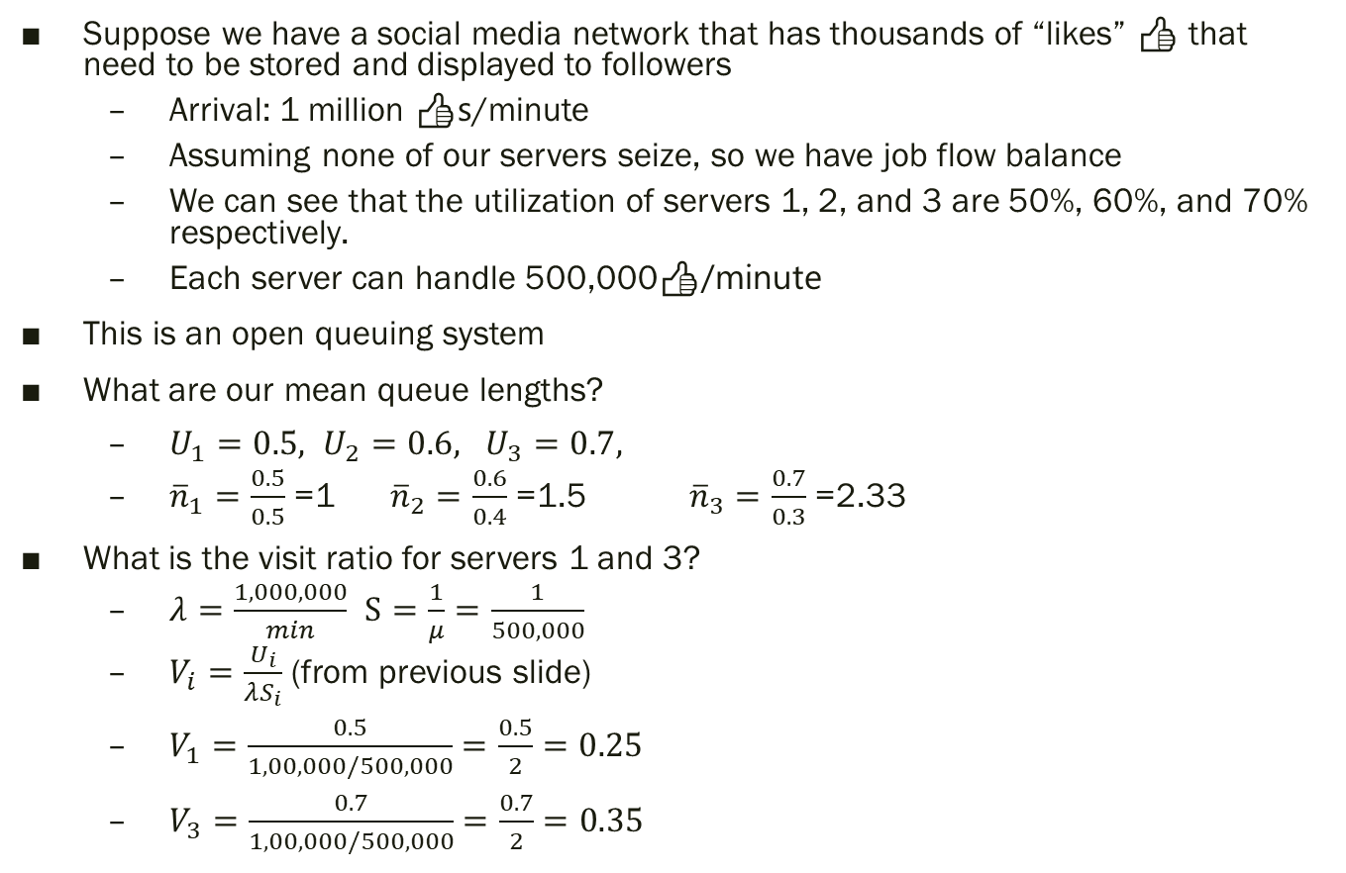
e.g. Processing “Likes”
Suppose we have a social media network that has thousands of “likes” 👍 that need to be stored and displayed to followers
  Arrival: 1 million 👍s/minute
  Assuming none of our servers seize, so we have job flow balance
  We can see that the utilization of servers 1, 2, and 3 are 50%, 60%, and 70% respectively.
  Each server can handle 500,000👍/minute
This is an open queuing system
What are our mean queue lengths?
  $U_{1}=0.5, U_{2}=0.6, U_{3}=0.7,$
  ${\overline{n}}_{1}=\frac{0.5}{0.5}$ =1 ${\overline{n}}_{2}=\frac{0.6}{0.4}$ =1.5 ${\overline{n}}_{3}=\frac{0.7}{0.3}$ =2.33
What is the visit ratio for servers 1 and 3?
  $λ=\frac{1,000,000}{min}$ $S=\frac{1}{μ}=\frac{1}{500,000}$
  $V_{i}=\frac{U_{i}}{λS_{i}}$ (from previous slide)
  $V_{1}=\frac{0.5}{1,00,000/500,000}=\frac{0.5}{2}=0.25$
  $V_{3}=\frac{0.7}{1,00,000/500,000}=\frac{0.7}{2}=0.35$

Slide 5
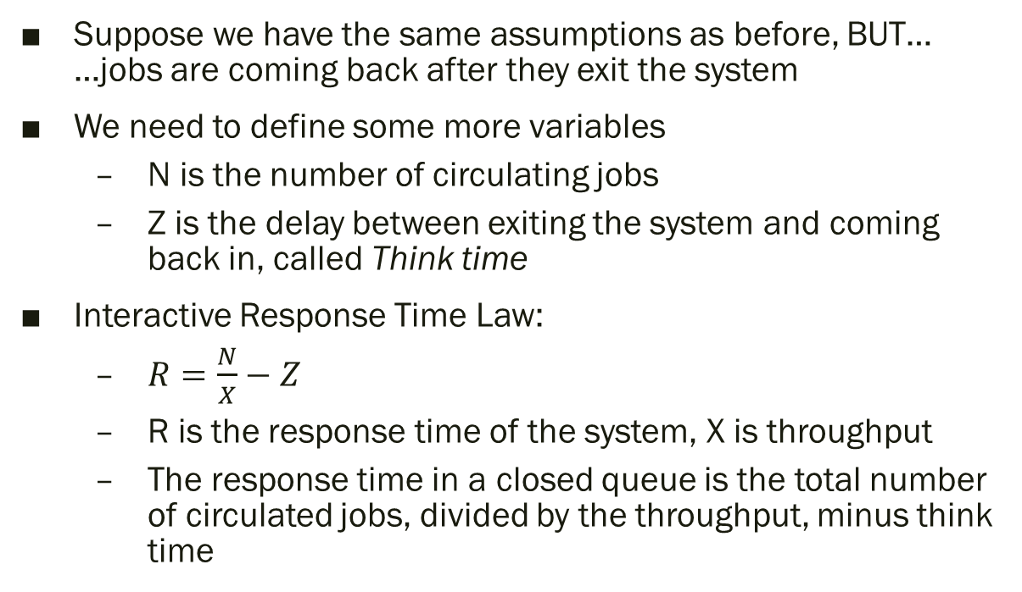
Closed Queuing: Response Time Laws
Suppose we have the same assumptions as before, BUT…
…jobs are coming back after they exit the system
We need to define some more variables
  N is the number of circulating jobs
  Z is the delay between exiting the system and coming back in, called Think time
Interactive Response Time Law:
  $R=\frac{N}{X}−Z$
  R is the response time of the system, X is throughput
  The response time in a closed queue is the total number of circulated jobs, divided by the throughput, minus think time

